Slide 1
1D Poisson
PHYS3112 – Tutorial 5

Slide 2
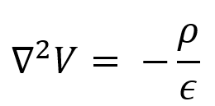
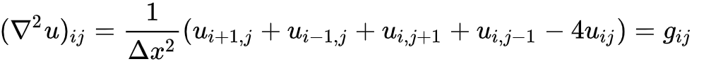
1D Poisson Equation
Sometimes, a DE can’t be solved by simply iterating one thing after another.
An example of this is the Poisson equation:
Which has a 2-D stepping function:
(See week 5 lecture notes for how this sort of stepping function is derived)

Slide 3
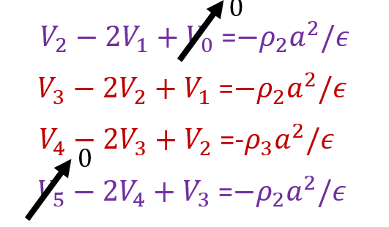
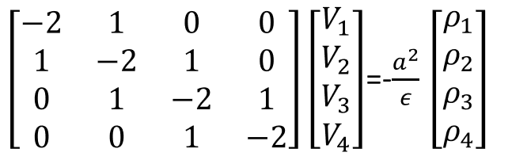
The Tridiagonal Matrix
If you arrange the stepping function into a series of equations, you’ll yield a matrix:
(Again, refer to week 5 lectures; these are just screenshots!)
1
4

Slide 4
How do we solve it?
There’s a rather nice algorithm called the ‘Thomas Algorithm’ that is computationally efficient. Specifically works for tridiagonal matrices.
However, we can simply do matrix inversion in python. (note; this is very inefficient for large data sets!)

Slide 5
Example – Matrix Inversion
Matrix inversion is pretty easy.
If you have your Poisson matrix (A) and your rho-vector (B), then the voltages (V) at each point are the solution to the equation AV = B.
This can be easily solved using numpy’s linalg solver; numpy.linalg.solve(A,B) will return V.

Slide 6
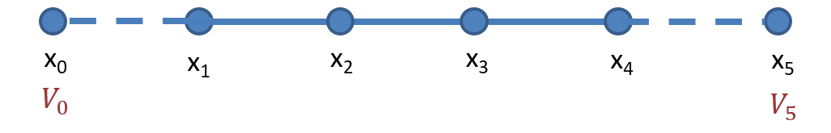
Boundary conditions – Edge Voltage (Dirichlet Boundary condition)
A key thing to be able to do is to modify your poisson matrix to account for boundary conditions.
For example, what if the edge values of voltage are constrained to be a certain value?
This introduces two extra terms: V0 and V5 into our (four by four) matrix. Do we now have a 6x6 matrix?

Slide 7
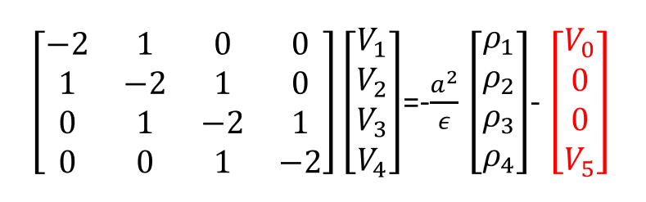
No! Because V0 and V5 only show up once apiece, we can modify their sections of the matrix only:
So we can complete these boundary conditions by modifying the rho vector. (again, derivation shown in lecture)

Slide 8
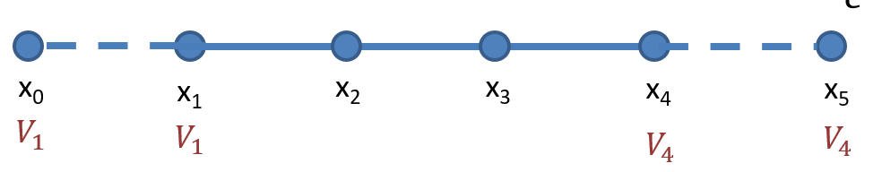
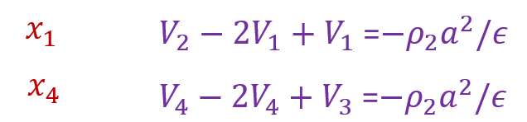
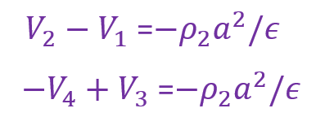
Boundary Condition: Constant Gradient (Neumann Boundary condition)
We can also specify the gradient at the boundaries of our simulation. This is equivalent to fixing the relationship between the edge values and the off-edge values.
This changes our equations!
becomes

Slide 9
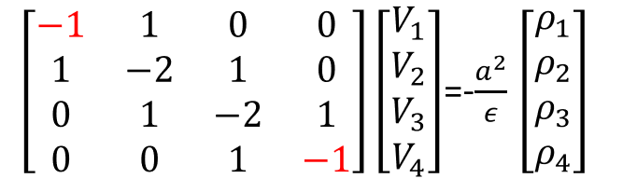
Finally, we get a matrix simplification

Slide 10
Your tasks
Make your way through the advanced tutorial notebook, and ensure you understand the process of matrix solving.
Go through lecture notes and try to understand how the Poisson matrix is derived (and ask me for help!)
Experiment with a variety of boundary conditions; for example, what if the gradient was set such that V1 = 2V0? How would that change the Poisson matrix?

Slide 11
Further steps
So far this is still only 1D
We have fixed our Step size (a) to be constant for all positions in our mesh
It is time constant
Other questions / comments? Please let me know! There is a lot of ground that can be covered and I’m unsure as to what you would like.

